Slide 1
C-LAB ASSISTANT

Slide 2

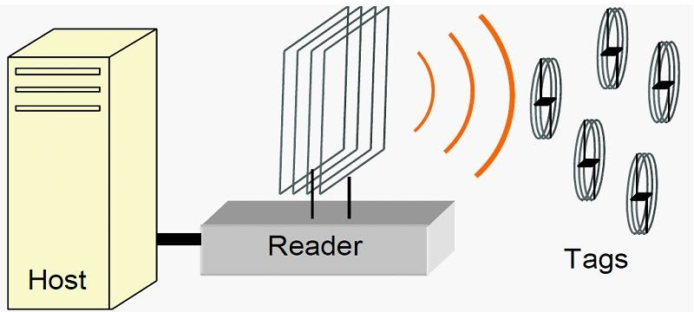
Abstract
The laptops in the laboratory will be equipped with a RFID tag which will transmit signal in a range.
The laptop of the lab assistant will be equipped with another RFID tag that will work in a limited range and receive signal.
<number>

Slide 3
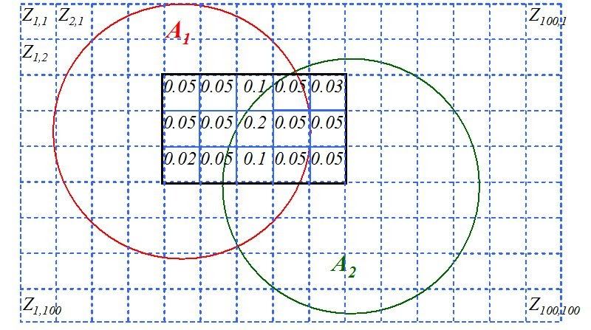
The laptop of the lab assistant will have a database that will have information about all the devices in the laboratory. It will match the signals coming from the nearby devices to the database and as long as all the devices are connected, there will be no problem.
<number>

Slide 4
Motive
Whenever any device goes out of range, it will keep prompting to return in range. The lab assistant will be informed that there is a device out of range and provide information about which one so that he can retrieve that immediately.
Soon after all the devices are in range again, the database will be in sync and things will get back to normal.

